Slide 1
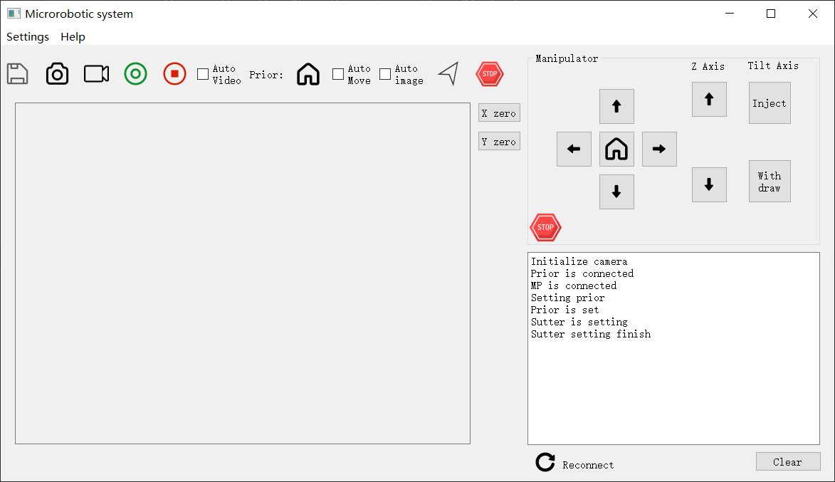
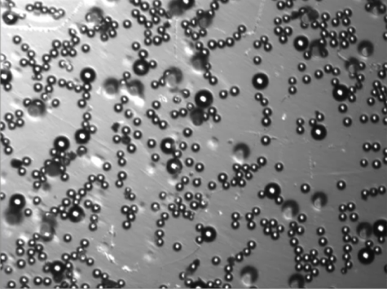
3-DOF
Micromanipulator
Motorized stage
Objective
Camera
Microscope

